Slide 1
Employee Data Analysis using Excel
STUDENT NAME: SOUNDHARYA K
REGISTER NO: asunm1429122202650
DEPARTMENT: B Com CS
COLLEGE: ALPHA ARTS AND SCIENCE COLLEGE

Slide 2
PROJECT TITLE
Employee Attendance Analysis using Excel

Slide 3


AGENDA
Problem Statement
Project Overview
End Users
Our Solution and Proposition
Dataset Description
Modelling Approach
Results and Discussion
Conclusion
3/21/2024 Annual Review

Slide 4

PROBLEM STATEMENT
Develop a system to analyze employee attendance patterns, identify trends and anomalies, and provide actionable insights for improving workforce management.
The system should process attendance data, generate reports, and alert managers to significant deviations, ensuring effective integration with existing HR and payroll systems.

Slide 5

PROJECT OVERVIEW
.
To design and implement a system that analyzes employee attendance data to improve workforce management by identifying patterns, trends, and anomalies.

Slide 6

WHO ARE THE END USERS?
HR Managers: Oversee attendance tracking and enforce attendance policies.
Payroll Administrators: Use attendance data to calculate and manage payroll.
Team Leaders/Supervisors: Monitor team attendance to manage productivity and address issues.
Upper Management: Analyze overall attendance trends for strategic decision-making

Slide 7

OUR SOLUTION AND ITS VALUE PROPOSITION
Conditional formatting - Blank value.
Filter-Missing values, also known for a sorting data within a file.
Formula - Allocate the attendance of the employees.
Pivot Table - To summarize, organize, and analyze large amounts of data in a variety ways.
Graph - Represent the data in visualize of illustrate relationships in data.

Slide 8
Dataset Description
Employee Data Set - Kaggle
Total features - 29
Features - 9
Employee id - Numerical value
Name - Text
Gender - Male, Female
Employee type – Text
Performance score - Text

Slide 9

THE "WOW" IN OUR SOLUTION
We have taken the employee type field to ascertain the “Employees Attendance Analysis” using pivot table
3/21/2024 Annual Review
9

Slide 10
MODELLING
Data collection
Kaggle-Using this website to collect the data for the project.
Feature collection
Excel spread sheet - Excel sheet is used to arrange the relevant data.
Data cleaning
Conditional formatting - Used to identify the blank area. Filter Option This option is used to remove the blanks
10

Slide 11
SUMMARY
Pivot table - We use the pivot table to get crisp and clear data about the employee performance. For that we used the below details:
Filter - employee type
Column – Employee attendance
Row - Business Unit
Value - Count of First name
Visualization
Graph-Graph show the result of this analysis.
11

Slide 12
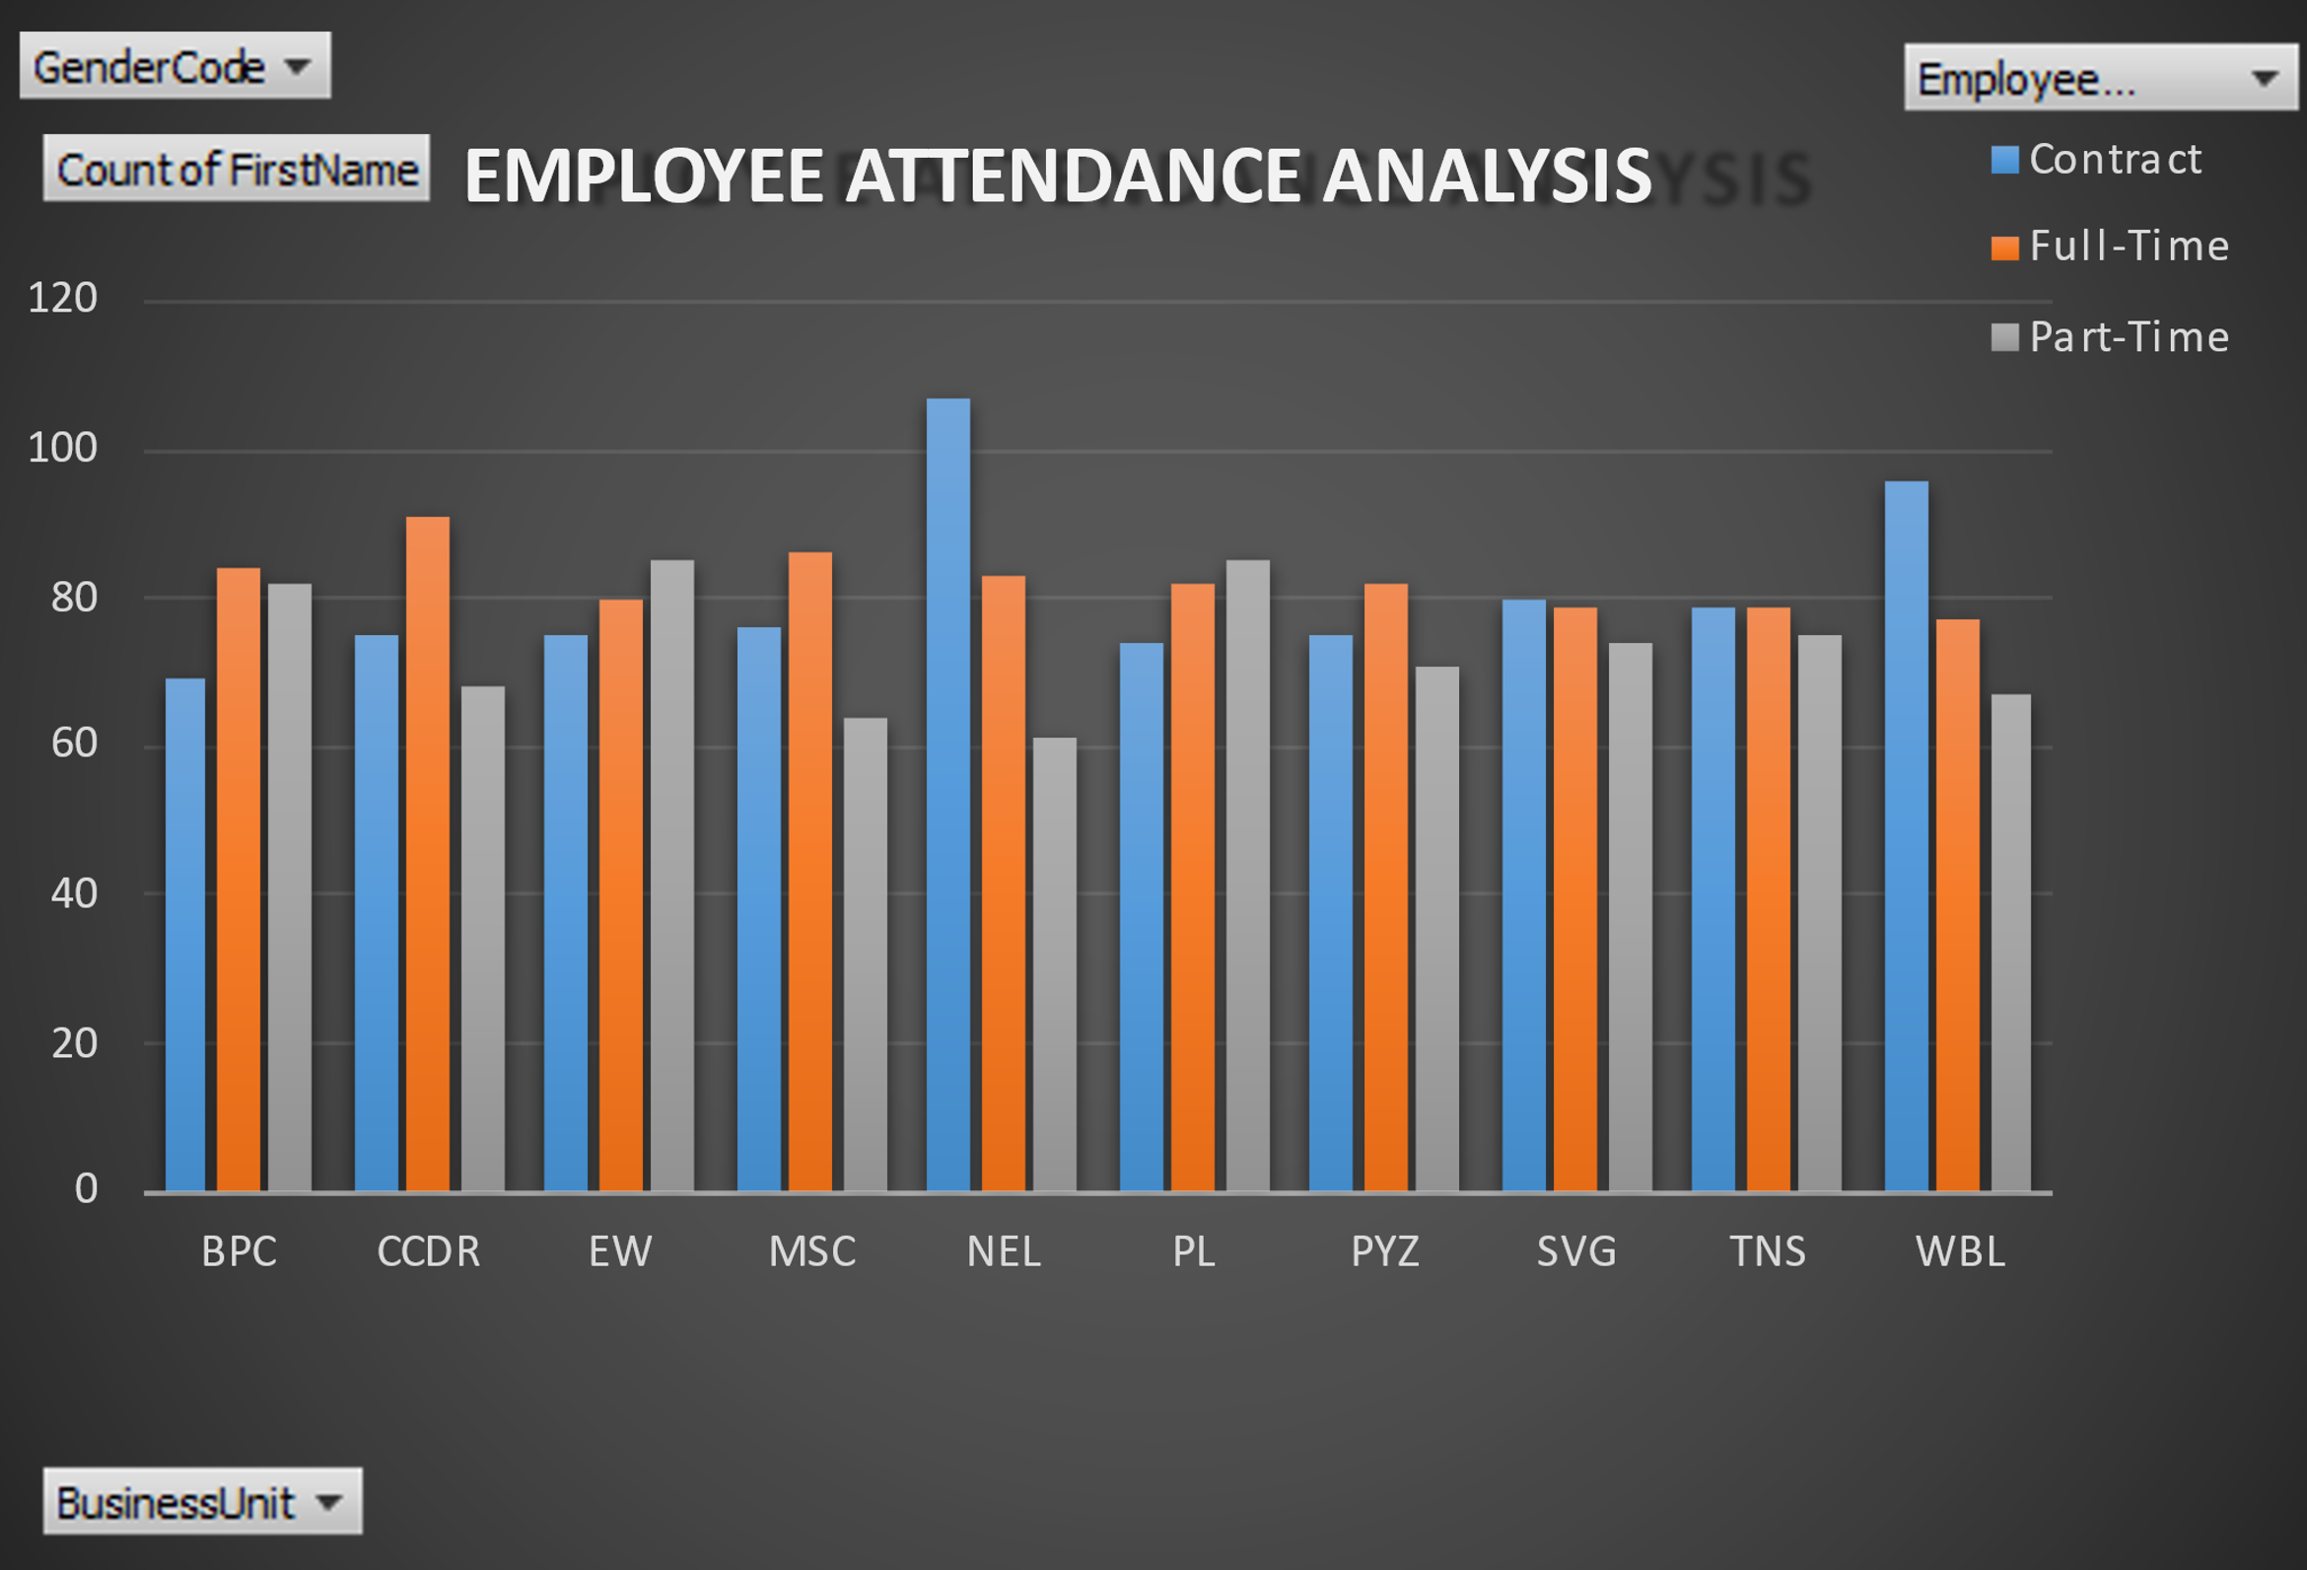
RESULT
12

Slide 13
Conclusion
In summary, the analysis reveals notable trends in absenteeism and punctuality that impact productivity.
Key issues include frequent absences in specific departments and recurring lateness.
To address these, it is recommended to implement targeted interventions, such as revising attendance policies and offering support programs, to enhance overall attendance and operational efficiency.

